Slide 1
Avocado Sales Analysis & Strategic Recommendations
Presented to: Grocery Store Consortium
Presented by: Rushang Tailor, Junior Data Analyst

Slide 2
Agenda
Introduction & Business Task
Key Finding 1: Price & Volume Trends
Key Finding 2: Conventional vs. Organic Market
Key Finding 3: Top Performing Regions
Key Finding 4: Seasonal Demand Peaks
Summary of Insights & Actionable Recommendations

Slide 3
Our Business Task
To analyze historical avocado sales data (2015-2018) to identify key trends.
Our objective is to provide data-driven recommendations that help member stores:
Optimize Pricing Strategies
Plan Effective Promotions
Improve Inventory Management

Slide 4
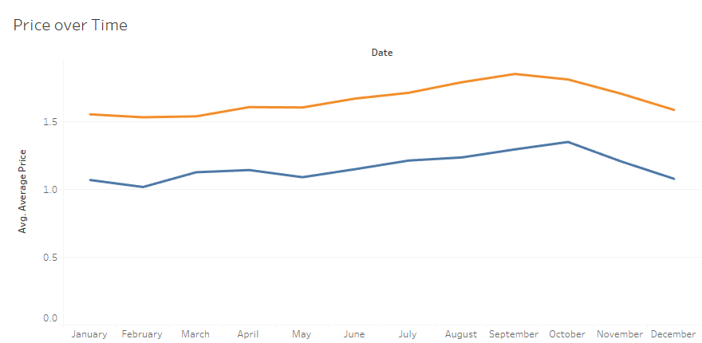
Finding 1: Price Trends Over Time
Avocado prices were volatile from 2015-2018, with a notable price spike in 2017. Organic avocados consistently command a higher price.

Slide 5
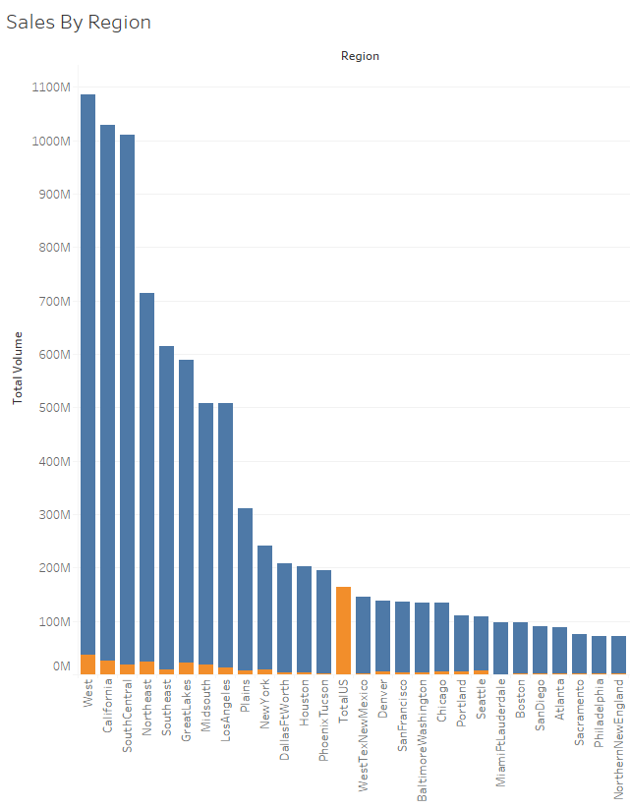
Finding 2: Top Performing Regions
Sales are not evenly distributed. A few key regions are responsible for the vast majority of total sales volume.
California, West, and SouthCentral are the top 3 regions.

Slide 6
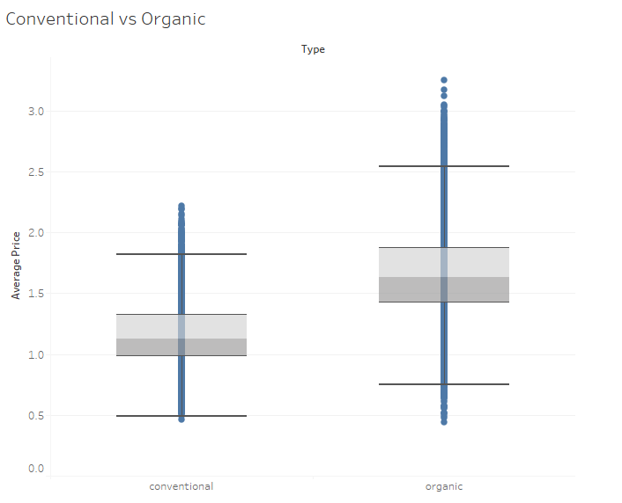
Finding 3: Conventional vs. Organic
Conventional avocados dominate the market, driving the vast majority of total sales.
Organic avocados are consistently 40-60% more expensive than conventional.

Slide 7
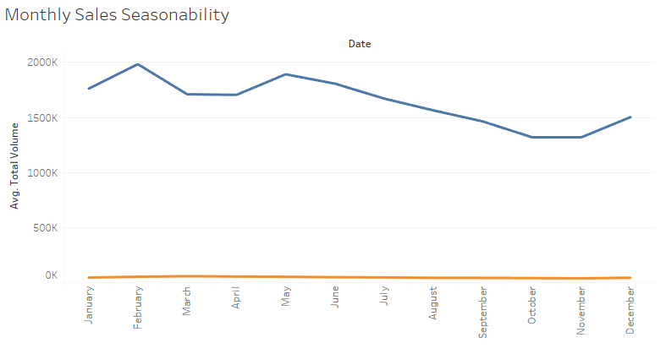
Finding 4: Seasonal Demand Peaks
Sales volume shows two major spikes every year.
Highest sales volume in February
Second major spike in May

Slide 8
Recommendations 💡
Launch targeted campaigns like "Game Day Guac" in January and "Fiesta Offers" in April to capitalize on peak seasonal demand.
Market organic avocados as a premium product. Focus on quality, not price. Ensure prominent in-store placement.
Implement region-specific inventory strategies. Increase stock in high-volume regions like California during peak seasons to prevent stockouts.
Marketing & Promotions
Pricing & Placement
Inventory Management

Slide 9
Thank You
Q&A

